Slide 1



Collabnest –Flying collaborately
Your All-In-One Collaboration solution

Slide 2
Agendas
Introduction
Key Features
Support
& Training
Need of Collaboration tools
Why CollabNest ​​
over others?​​​
Diagrams & Figures
Meet
CollabNest
Methodologies and tools to be used​
Conclusions
Q & A

Slide 3

Introduction
Welcome to the world of CollabNest, where teamwork meets innovation.
Objectives:
In this presentation, we'll explore the purpose and features of CollabNest, an application designed to streamline team collaboration.
3

Slide 4


Why Collaborate?:
Collaboration in an Organization is a key towards success. Organization where team cannot communicate and collaborate properly has hard time performing everyday tasks and achieving milestones in work.
Need of
Collaboration tools
Problems in absence of collaboration tools:
Communication gaps
Information silos
Fragmented tools
Remote work challenges

Slide 5
Meet CollabNest
Overview:
CollabNest is an innovative collaboration platform providing every tools and components needed managing an Organization at all levels. It provides various features like clock in,
chats, drive, feed, calendar ,tasks scheduling which benefits employees at all level. It also involves ability to have direct talk with clients within the platform which ensures efficiency and effectiveness of work.
Objectives:
Our objective to create a platform which provides effective communication and collaboration within the team members , connecting employees of on-site as well as remote working together to accomplish the task. The platform will empower organizations with the tools they need to thrive in a collaborative, data-driven world.
5

Slide 6
News feed where we can post notices and news.
Chats section within employees and personnels of all higher and lower levels.
Open Channels where we can communication with clients to address their problems and queries.
Drive where we can upload important documents and files of accomplished works.
Tasks Section where we can create a task and schedule it.
Clock in and out features which allow us to keep track of work done.
Calendar which helps to schedule tasks .
Key Features
6

Slide 7
Why CollabNest Over others?
User friendly
design
Scalable for
Any size of Organization
Customization as per needs
7

Slide 8
Methodologies and tools to be used
Methodologies:
In this project, we are using Incremental approach to complete the task where we would build module by module. This approach will align with our goals and plan to conduct the project.
Tools to be used:
Following different tools and languages are used to build this innovative product :
Project Management : Jira
Prototyping tools :Figma
Version Control tools: Git ,GitHub
Software Development : Flutter, Express JS
API Development and testing : Postman
Database Management tools: MongoDB, Firebase
8

Slide 9
Support and Training
Tailored Training Programs
Regular Updates
Community Engagement
24/7 services

Slide 10
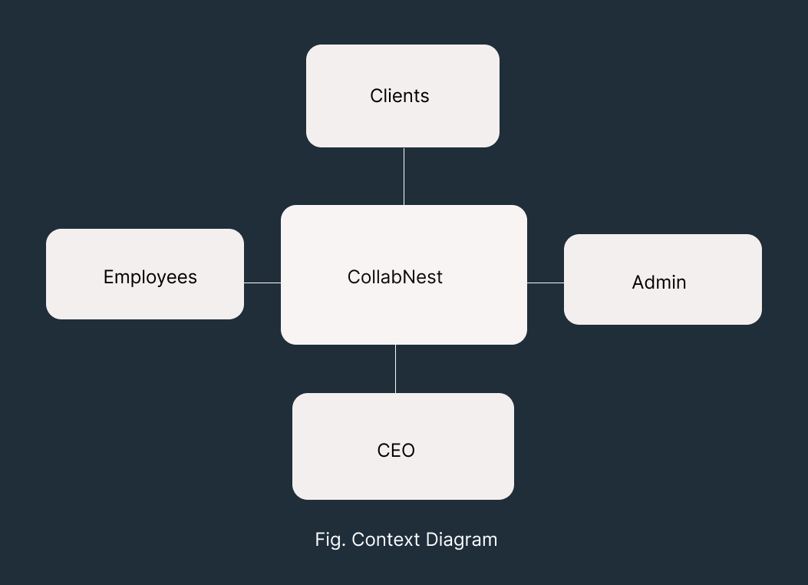
Diagrams and figures
10

Slide 11
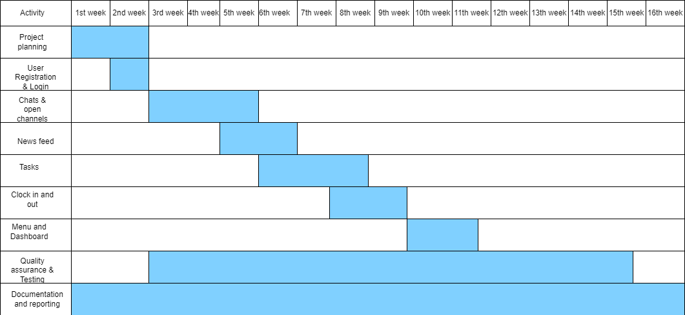
Diagrams and figures
Fig 2. Gantt Chart
11

Slide 12

Conclusions
In summary, CollabNest stands as the solution to past collaboration challenges. With its intuitive interface, robust support, and tailored training, CollabNest empowers teams to overcome communication gaps, eliminate data silos, and streamline workflows. As we embrace a future of seamless collaboration, CollabNest is your catalyst for enhanced productivity, efficient project management, and successful team outcomes.
12

Slide 13




Q & A
Any questions regarding this
Revolutionizing Team Collaboration Platform?

Slide 14
Thank you !!
Presenters:
Rakshya Bastola
Prakash Basnet

